Slide 1
Unit 10
Software Management
Software Engineering
CSIT 6th Semester

Slide 2
Syllabus
Software Project Management;
Project Management Activities
  Project Planning,
  Risk Management,
  People Management,
  Reporting and Proposal Writing
Project Planning
  Software Pricing,
  Plan-Driven Development,
  Project Scheduling,
  Estimation Techniques,
  COCOMO Cost Modeling
Introduction to Quality Management and Configuration Management

Slide 3
Software project management
Software Project Management (SPM) is a proper way of planning and leading software projects in which software projects are planned, implemented, monitored and controlled to deliver quality products on time and within budget.
Software project management is an essential part of software engineering. Good management cannot guarantee project success however bad management usually results in. Project failure i.e. software delivered late, cost more than originally estimated and fails to meet its requirement.

Slide 4
Software project manager
A software project manager is a person who undertakes the responsibility of planning, executing and controlling the software project.
A project manager closely monitors the development process, prepares and executes various plans, arranges necessary and adequate resources, maintains communication among all team members in order to address issues of cost, budget, resources, time, quality and customer satisfaction.

Slide 5
Project management activities
Project manager's job varies depending on type of organization and software product being developed. So it is difficult to write standard job description for a software manager. Some common activities of project managers are as follows:
Proposal writing: Project manager have to write the project proposal to win a contract from the customer. Proposal writing is a skill that acquire through practice and experience. Proposal should include the objective of the project and how it will be carried out. It also includes cost and schedule estimates and justification why the project contract awarded to a particular organization or team.
Project planning and scheduling: Project planning is concerned with identifying activities, milestones and deliverable produced by a project. A plan is drawn up to guide the development team towards the project goals.
Resource Management: Assigning team members, hardware, software tools, and budgets to specific tasks based on availability and skill sets.
Risk Management: Identifying, analyzing, and mitigating potential risks—such as technical hurdles or schedule delays—before they harm the project

Slide 6
Project management activities
People management:
  Role Definition: Assigning specific titles and clear responsibilities like Frontend Developer, QA Engineer, or DevOps Specialist.
  Team Composition
  Motivation and Engagement
  Conflict Resolution
  Performance Evaluation:
  Skill Development:
  Productive Environment:
Reporting and Presentation: Project managers are usually responsible for reporting on the project to both the client and contractor organization. They have to write concise, coherent documents that abstract critical information to detailed project report.

Slide 7
1.Project Planning
it is a set of multiple processes, which facilitates software production to complete its completion in given set of resources and time frame.
The project plan sets out the resources available to the project, the work breakdown and a schedule for carrying out the work. So, effective management of software project depends on the thoroughly planning the progress of project. A plan drawn up at the starting of a project should be used as driver for the project.

Slide 8
Plan sections
Introduction: It describes the objectives of the projects and sets out the constraints like budget, time etc that affect the project management.
Project organization: It describes the way in which development team is organized, the people involved and their role in the team.
Risk analysis: This describes the possible project risk, the likelihood of these risks arising and the risk reduction strategies that are proposed.
Hardware and software resource requirement :This specifies the hardware and software required to carry out the development. If the hardware has to be bought estimates of prices and delivery schedule may be included.
Work breakdown: In this phase the project is breakdown into activities and identifies the milestones and deliverables associated with each activity.
Project schedule: This phase shows the dependencies between activities the estimated time required to reach each milestone and allocation of people to each activity.
Monitoring and reporting mechanism: This defines the management report that should be produced.

Slide 9
Types of Plan
Validation plan: It describes the approach, resources and schedule used for system validation. It is intended to show that the program does what the user requires.
Configuration and management plan: This plan includes the management of system change. When a system is maintained the role of the CM team is to ensure that changes are incorporated in a controlled way. This plan includes configuration management procedures and structures to be used.
Maintenance plan: It predicts the maintenance requirements of the system, maintenance cost and effort required.
Staff development plan: It describes how the skill and experience of the project team member will be developed.

Slide 10
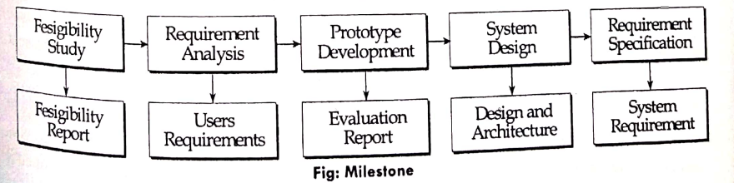
Milestone and deliverables
Milestones: Project milestones are the predictable outcome of an activity where some formal report of progress. Milestones are the recognizable end point of software process activity. Milestones should represent the end of a distinct, logical stage in the project.
Deliverables: A deliverable is a project report (result) that is delivered to the customer at the end of tome major project phase. Deliverables are usually milestones but milestones need to be deliverables. The project deliverable, which are delivered to customer are the requirement definition and requirement specification.

Slide 11
2. Project scheduling
The time and resources required to complete activities and organize them into a coherent sequence.
Project scheduling means separating the total work involved in a project into separate activities and organize the work so that the work force is optimal following are the principle for scheduling.
  Compartmentalization: Define district task
  Interdependency: Parallel and sequential task
  Time allocation: Assigned, personals, resources, days, start time and end time
  Effort validation : Be sure Resources are available
  Defined responsibilities
  Defined outcome : Each task must have an outcome

Slide 12
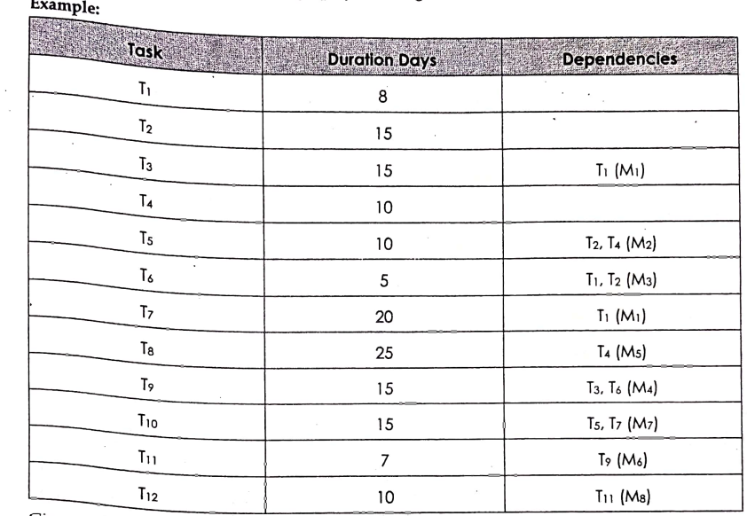
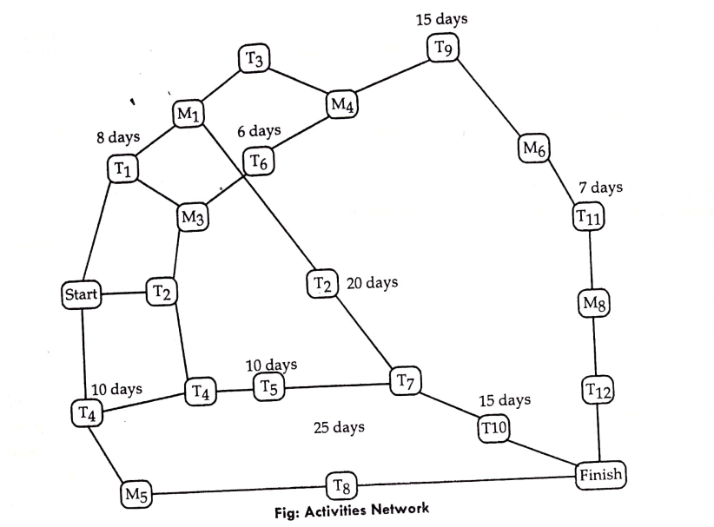
2. Project scheduling
Project scheduling is done using graphical representations(bar chart, gantt chart, activity network diagram etc) showing project activities, their duration and staffing.

Slide 13
3.Risk management
The risk management is process of identifying risks that might affect the project schedule or quality of the project/software being developed and taking action to avoid these risks.
Risk management involves identifying and assessing major project risks to establish the probability that they will occur and the consequences for the project if that risk does arise.

Slide 14
Types of risks in SPM
Product Risk: Product risks are the risks that influence the quality attributes as well as performance of software being developed. Example: failure of purchase component to perform as expected .
Project Risk: Project risks are the risks that influences the schedule of software project and that if occur delay the development process. Example: staff turnover, hardware unavailability etc.
Business Risk: Business risk is a risk that affects the organization business that is developing or procuring the software. it could be anything that has the potential of threatening the generation of profits at the predetermined boe quite dangerous target levels. Business risks for the long-term

Slide 15
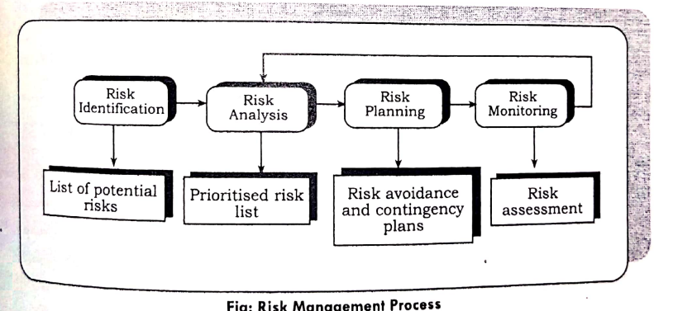
Risk management process
Risk identification is the first stage of project risk management that focuses on discovering potential project risks through brainstorming and past experience.
Types of risk that may arise:
Technology Risk: The risk that derive from the software or hardware technology that are used to develop a system.
People Risks: The risk that are associated with the people in the development term are people risks.
Organizational risks: Risks that derive from the organizational environment where the software being development.
Tool Risks: Risks that derive from the CASE tools and other support software used to develop the system.
Requirement Risks: Risks that derive from the change to the customer requirement and the process of managing the requirement change.

Slide 16
Risk management process
2. Risk Analysis: In this phase all identified risks are considered and make a judgment about problems causing risk in the project, identify probability of occurrence of risk and the impact of the risk. The probability of risks may be accessed as very low (<10%), low(10-25%), moderate (26-50%), high(51-75%) and very high(>75%). Risks are tabulated in order according to the seriousness of the risk.

Slide 17
Risk management process
3. Risk planning: Risk planning is the process of consideration of the key risks that have been identified and formulation of strategies to manage the risk. It is not a simple process; it depends on the judgment and experience of the project manager. the strategies to manage the risk are as follows:
i. Avoidance Strategies: This strategy tells that the probability that the risk will arise will be reduced. Example: The strategy for dealing with defective components.
ii. Minimization Strategies: These strategies mean that the impact of the risk will be reduced.
Example: Staff illness, Reorganize team so that there is more overlap of work and people therefore understand each other's job.
iii. Contingency Plans: These strategies means that you are prepared for the worst and have a strategy in place to deal with it.

Slide 18
Risk management process
4. Risk monitoring: Risk monitoring means regularly assessing each of the identified risk to decide whether or not the risk is becoming more or less portable and whether the effect of the risk have changed. It should be a continuous process, and at every management progress review.

Slide 19
Plan driven development
Plan-driven development is an approach where the development process is thoroughly planned in advance, and progress is measured against this baseline plan. It is often contrasted with Agile.
Upfront Specification: Requirements, architecture, and design are finalized and documented before major development starts.
Predictability: Focuses on minimizing changes, making it ideal for large, critical systems (like aerospace or medical software) where safety and compliance are paramount.
Process Phases: Follows structured, sequential phases (e.g., Requirements → Design → Implementation → Testing → Maintenance).

Slide 20
Software pricing
Software pricing must take into account broader organizational, economic, political and business consideration. The major factors that affect the software pricing are as follows:
Development organization quotes a low price if want to move into a new segment of software market. Accepting low profit in one project may give the opportunity of more profit later.
If an organization has no idea about cost estimation then it may increase its price by some contingency.
It the customer is not clear about their requirement then there is chance of changing requirement at that time organization may lower its price. After contract is awarded then high prices may be charged for changes to the requirement.
If the financial health of the organization is not good then they may lower their price to gain contract and establish themselves in business.

Slide 21
Estimation techniques
The software estimation process includes estimating the size of software product, effort required, and overall cost of the project. The approaches to cost estimation can be tackled using either top-down or a bottom up approach.
1) Top-down Approach: Top-down estimating method is also called Macro Model. Using this method, an overall cost estimation for the project is derived from the global properties of the software project, and then the project is partitioned into various low-level components, This method is more applicable to early cast estimation when only global properties are known. This approach starts at system level.
Advantages:
It will not miss the cast of system-level functions.
It requires minimal project detail, and at is usually faster, easier to implement.
Disadvantages:
It often does not identify difficult low-level problems.
It provides no detailed bases for justifying estimates

Slide 22
Estimation techniques
2) Bottom-up Approach:
Using this method, the cost of each software components is estimated and then combines the results to arrive at an estimated cost of overall project. It aims at constructing the estimate of a system from the knowledge gained about small software. components and their interactions. The approach is COCOMO's detailed model. leading method using this.
Advantages:
It allows software group to handle an estimate in an almost traditional fashion.
It is more stable because the estimation errors in the various component's have a chance to balance out.
Disadvantages:
It tends to be more time-consuming
It may not be accurate because the necessary information may not be available in the early phase.

Slide 23
Cocomo model
COCOMO Model:
The Constructive Cost Model (COCOMO) is an algorithmic software cost estimation model. This model predicts or estimates the effort required for the project, total project cost, and scheduled time for the project. This model depends on the number of lines of code for software product development.
In COCOMO, projects are categorized into three types:
Organic: A software project is said to be an organic type if the team size required is adequately small, the problem is well understood, and has been solved in the past. Example of this type of projects are simple business systems, simple inventory management systems, and data processing systems.
Semi-detached: In this type the development consists of a mixture of experienced and inexperienced staff. Example of semi-detached system includes developing a new operating system, a database management system, and complex inventory management system.
Embedded: A software project with requiring the highest level of complexity, creativity, and experience requirement fall under this category. For example: ATM, Air Traffic control.

Slide 24
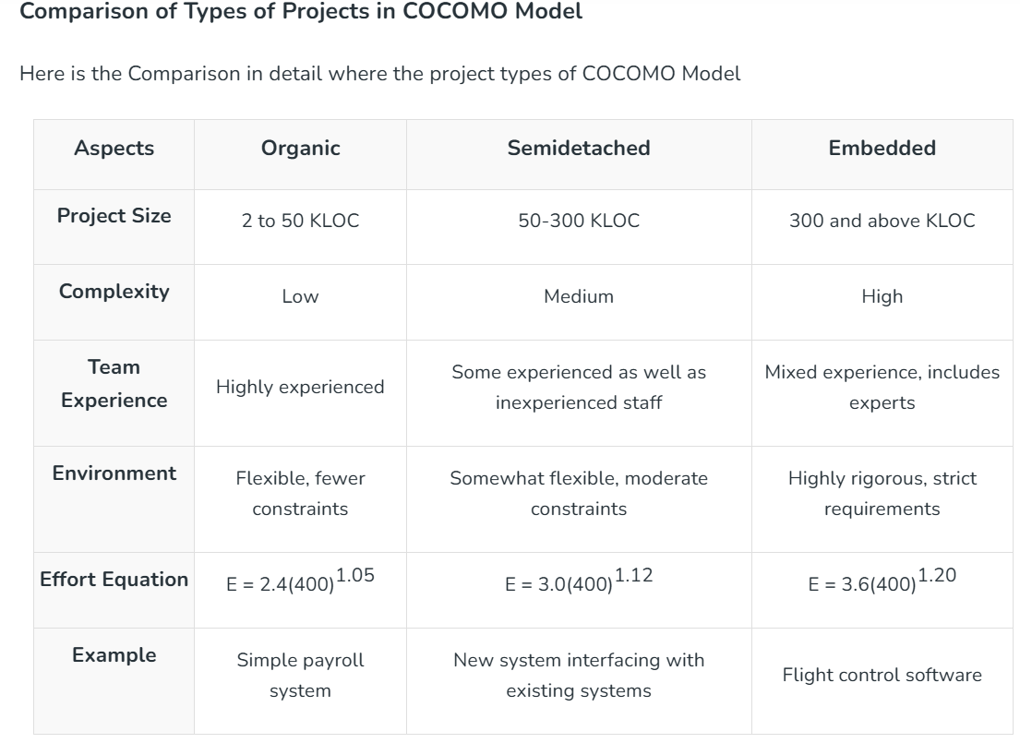

Slide 25
Types of cocomo model
Basic Cocomo Model
Intermediate Cocomo Model
Detaile Cocomo Model

Slide 26

Basic cocomo model
It is the one type of static model to estimates software development effort quickly and roughly. It mainly deals with the number of lines of code and the level of estimation accuracy is less as we don't consider the all parameters belongs to the project. The estimated effort and scheduled time for the project are given by the relation:
Effort (E) = a * (KLOC)^{b} PМ
Scheduled Time (D) = c*(Effort)^{d} Months(M)
Where, E = Total effort required for the project in Person-Months (PМ or MM).
D = Total time required for project development in Months (M).
KLOC = the size of the code for the project in Kilo lines of code.
a, b, c, d = The constant parameters for a software project.

Slide 27
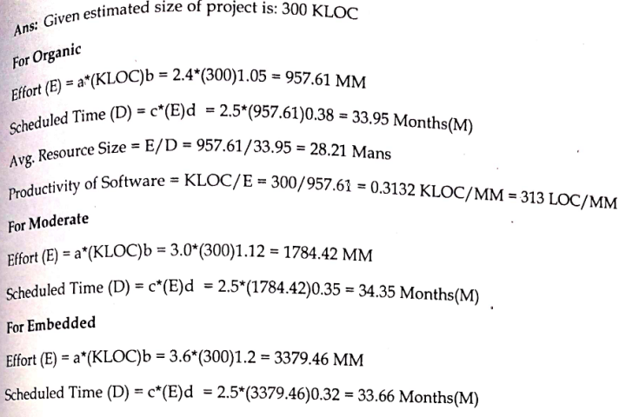
numerical
Example: For a given project was estimated with a size of 300 KLOC. Calculate the Effort, Scheduled time for development. Also, calculate the Average resource size and Productivity of the software for Organic project type.

Slide 28
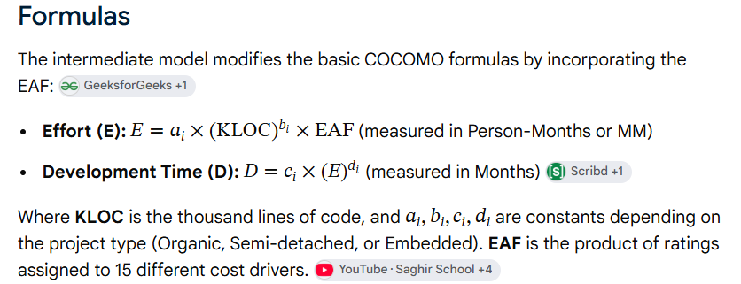
Intermediate cocomo
The Intermediate COCOMO (Constructive Cost Model) predicts software development effort and schedule by multiplying a basic size-based estimate by an Effort Adjustment Factor (EAF) derived from 15 specific cost drivers

Slide 29
Intermediate cocomo
15 Cost Drivers
The cost drivers are grouped into four major categories, rated on a scale from Very Low to Extra High:
Product Attributes:
  Required software reliability
  Size of application database
  Product complexity
Hardware Attributes:
  Run-time performance constraints
  Memory constraints
  Environment volatility
  Required turn-around time
Personnel Attributes:
  Analyst capability
  Application experience
  Programmer capability
  Virtual machine experience
  Programming language experience
Project Attributes:
  Use of software tools
  Application of software engineering methods
  Required development schedule

Slide 30
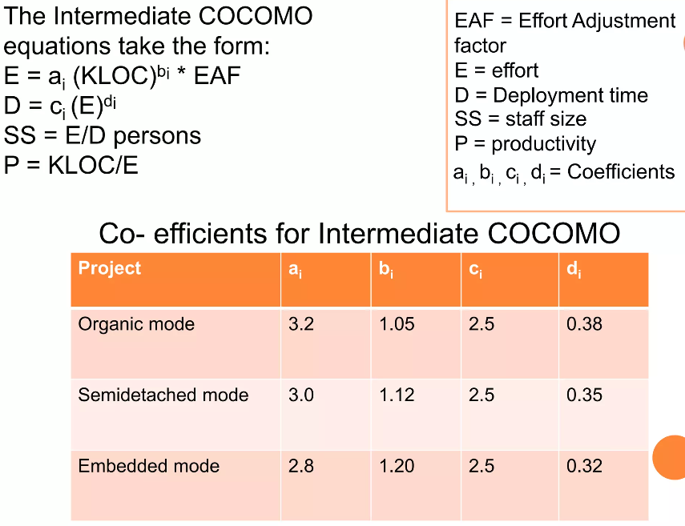

Intermediate cocomo
Intermediate cocomo

Slide 31
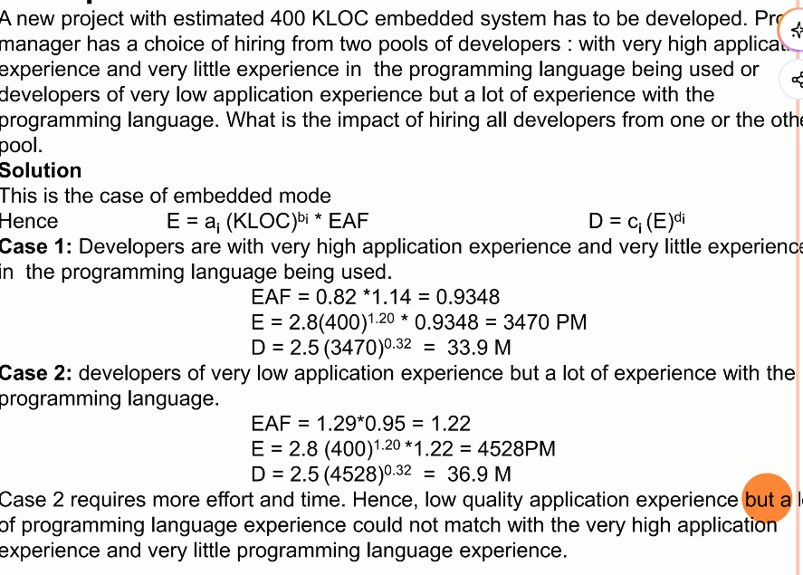
Intermediate cocomo
Intermediate cocomo

Slide 32
Detailed cocomo
The detailed COCOMO (Constructive Cost Model) is an advanced software cost-estimation framework that refines intermediate estimates by breaking a project into individual phases and applying phase-specific cost drivers to separate system modules
Six Phases of Detailed COCOMO
The software engineering process is divided into six distinct hierarchical phases:
Planning and Requirements: Defining scope, goals, and system specifications.
System Structure: High-level architectural design and database layout.
Component Structure: Detailed subsystem and module design.
Module Code and Test: Individual unit coding and testing.
Integration and Test: Putting modules together to verify overall system behavior.
Cost Constructive Model (Operation/Maintenance): Final tuning, deployment, and lifecycle adjustments.

Slide 33
Quality Management
Software Quality Management ensures the required level of quality is achieved by submitting improvements to the product development process.
Core Activities
1) Quality Assurance: Developing organizational procedures and standards for quality at an organizational level.
2) Quality Planning: Selecting and tailoring standards and procedures to create a project-specific quality plan.
3) Quality Control: Monitoring and verifying that the team follows established best practices during development.

Slide 34
Configuration management
Configuration management is the process of handling changes and keeping track of different versions in software systems.
It involves the policies, processes, and tools used to manage evolving software systems.
It prevents loss of track regarding which component versions and modifications belong to each system release.
Core Activities
Change Management: Keeps track of requests for changes to the software and assesses their impact.
Version Management: Manages multiple versions of software components and ensures that changes made by different developers do not conflict.
System Building: Combines program components, libraries, and configuration data to create an executable system.
Release Management: Prepares software for external or internal distribution, including packaging and documenting the release.

Slide 35
End of unit 10

